Slide 2
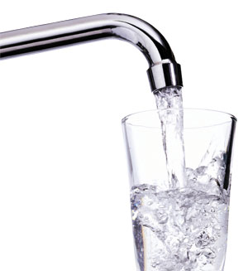
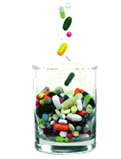
Microconstituents
“Pollutants we should care about”
Pure Water Forum and Shenandoah Valley Wastewater Treatment Plant Network
Deborah DeBiasi, Water Division - VPDES Permits
deborah.debiasi@deq.virginia.gov 804-698-4028
September 26th, 2019

Slide 3
What are microconstituents?
Natural and manmade substances in environment
Human and Veterinary drugs – prescription and OTC (Over The Counter) drugs
Pet products and supplements
Food Supplements – nutraceuticals (aka vitamins), caffeine, nicotine, fragrances
Sun-screen agents
Lotions, shampoos, soaps, deodorants, toothpaste
Cosmetics
Fire Retardants – PBDEs (polybrominated diphenyl ethers (penta, octa, deca), Organophosphate substitutions
Industrial Chemicals – bisphenol A, phthalates, PFAs, PFOS
Pesticides – bactericides, herbicides, fungicides, insecticides
Notes:
https://www.sciencedaily.com/releases/2017/05/170501102258.htm
Widespread vitamin D deficiency likely due to sunscreen use, increase of chronic diseases, review finds. Considered a hormone rather than a vitamin, vitamin D is produced when skin is exposed to sunlight. Vitamin D receptors are found in virtually every cell in the human body. As a result, it plays a wide role in the body's functions, including cell growth modulation, neuromuscular and immune function and inflammation reduction.
Symptoms for insufficient or deficient vitamin D include muscle weakness and bone fractures. People exhibiting these symptoms or who have chronic diseases known to decrease vitamin D, should have their levels checked and, if found to be low, discuss treatment options. Increasing and maintaining healthy vitamin D levels can be as easy as spending 5-30 minutes in midday sun twice per week. The appropriate time depends on a person's geographic location and skin pigmentation -- lighter skin synthesizes more vitamin D than darker skin. It is important to forgo sunscreen during these sessions because SPF 15 or greater decreases vitamin D3 production by 99 percent.

Slide 4
Names for this topic
CPC – Compounds of Potential Concern
PC - Pollutants of Concern
EC - Emerging Contaminants – (USGS)
CEC- Contaminants of Emerging Concern
        (AWRA-American Water Resources Assoc, EPA)
PPCP – Pharmaceuticals and Personal Care Products (name coined by Dr. Christian Daughton, EPA in 1999)
Microconstituents –(WEF -Water Environment Federation)
.
Notes:
PHARMACEUTICALS AND PERSONAL CARE PRODUCTS (PPCP'S) AS ENVIRONMENTAL POLLUTANTS: POLLUTION FROM PERSONAL ACTIONS
https://cfpub.epa.gov/si/si_public_record_report.cfm?direntryid=66501
https://www.epa.gov/wqc/contaminants-emerging-concern-including-pharmaceuticals-and-personal-care-products
https://www.epa.gov/wqc/contaminants-emerging-concern-including-pharmaceuticals-and-personal-care-products

Slide 5
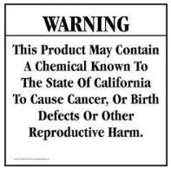
Endocrine Disrupting Compounds
An endocrine disruptor is a synthetic chemical that either mimics or blocks hormones and disrupts the body's normal functions when absorbed into the body.
Natural products in environment (oak tree leaves, other decaying matter), household cleaners, personal care products, pharmaceuticals, pesticides, processed foods, plants (contain natural compounds called phytoestrogens), plastics, industrial chemicals, animal and veterinary sources, air deposits of fire retardants, etc.
  https://www.epa.gov/endocrine-disruption- Endocrine Disruptor Screening Program (EDSP)
  List of EDCs – approx 10,000 chemicals
  Some products will contain this statement (or something
  similar) on the label, “Do not use if you are pregnant or
  breast-feeding” or “Do not expose children under 5 years
  of age” which could indicate the product contains EDCs
Notes:
California recently listed glyphosate as a known carcinogen
Roundup: The herbicide active ingredient in Roundup is glyphosate, which if sprayed on the lawn will kill not only the weeds but the lawn. This is a nonselective herbicide that controls any green plant on which it is applied.
Roundup For Lawns: The new Roundup For Lawns does not contain glyphosate. The herbicide active ingredients in Roundup For Lawns are MCPA, quinclorac, dicamba and sulfentrazone. These herbicides are effective on a broad range of weeds that might infest the lawn such as dandelion, crabgrass and nutsedge. When used properly it will not kill the desirable turfgrasses in the lawn. This is a selective herbicide that controls specific weeds, but not lawn grasses. To make it even more confusing there is a northern and a southern version of this product for different grass options. The northern version of Roundup for Lawns contains MCPA, quinclorac, dicamba and sulfentrazone. These active ingredients can be found in many lawn herbicides in different combinations for various weed control options. MCPA, 2,4-D and dicamba are products used to control broad leaf weeds such as dandelion, ground ivy or mallow. Quinclorac is often added to provide post-emergent control of crabgrass. Sulfentrazone is a product that provides control of sedges such as yellow nut sedge as well as some broadleaf weeds. All of the active ingredients previously mentioned will not kill your lawn grasses.
https://news.wsu.edu/2019/04/23/wsu-researchers-see-health-effects-across-generations-popular-weed-killer/
Parents and first generation ok – second generations had significant increases in testis, ovary and mammary gland diseases and obesity. Third generation males increase in prostate disease, females has increase in kidney disease. Generational toxicology, or epigenetics.

Slide 6
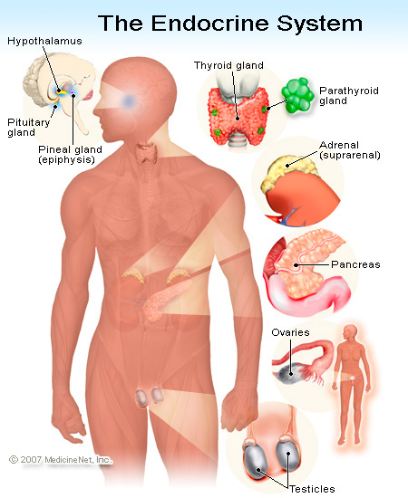
Endocrine System
Glands that produce and secrete hormones
Hormones regulate growth, metabolism, sexual development and function
Pituitary gland, hypothalamus, thyroid gland, parathyroid glands, adrenal glands, pineal body, reproductive glands, pancreas
Notes:
https://www.epa.gov/endocrine-disruption/what-endocrine-system

Slide 7



Sunscreens
Physical mineral sun blockers
titanium dioxide
zinc oxide
Usually white but
some more sheer
Safe and effective
Covering up with clothing best!
Chemical sun blockers
oxybenzone* - in 2/3 sunscreen products, also in chapstick
octinoxate*
Usually clear
Potential hormone disruptor
Allergenic, absorbed thru skin
Found in blood, urine, and breast milk
Notes:
https://www.ewg.org/sunscreen/report/executive-summary/
Oxybenzone works by absorbing a particular wavelength of UV and converting it to heat energy so you don’t get burnt
https://www.bayjournal.com/article/researchers_find_sunscreen_chemicals_in_chesapeake_oysters?utm_source=Bay+Journal+Weekly+News&utm_campaign=6e69d0317f-Newsltr_2019_Sep16&utm_medium=email&utm_term=0_bde9036159-6e69d0317f-69486921

Slide 8

Benefits and Deterrents of Sun Exposure
Sun exposure:
+Vitamin D uptake in body prevents osteoporosis and bone fractures
+Benefits children to make strong bones and prevent rickets
+Lower risk of MS
+May benefit people with MS
+10-15 (or 5-30) minutes of sun exposure 2-3 times/week is all body needs.
- Too much sun causes sunburn and may contribute to skin cancers
Little to no sun exposure
Need Vitamin D supplement
Vitamin D deficiency is risk factor for cardiovascular issues like heart attacks, high BP, diabetes, and some cancers. Need minimum 600 IUs daily
- Brittle bones - osteoporosis
Notes:
https://www.mnn.com/health/fitness-well-being/stories/benefits-of-vitamin-d?utm_source=Weekly+Newsletter&utm_campaign=d31e55717e-RSS_EMAIL_CAMPAIGN_FRI0913_2019&utm_medium=email&utm_term=0_fcbff2e256-d31e55717e-42469305
https://www.technologynetworks.com/proteomics/news/a-new-study-shows-that-vitamin-d-deficiency-is-strongly-linked-to-increased-mortality-and-324135?utm_campaign=NEWSLETTER_TN_Breaking%20Science%20News&utm_source=hs_email&utm_medium=email&utm_content=77085601&_hsenc=p2ANqtz--b6lsPCTzWndzLf4LAUoVGkMqPU3mXo_vW77B1JPodvAjRJDpPmdjPC6GHH37ygbxUyRir1yfyFQWww3QpNWN-0bL8zOuICxGayJ-5Px3tIR4UkME&_hsmi=77085601

Slide 9
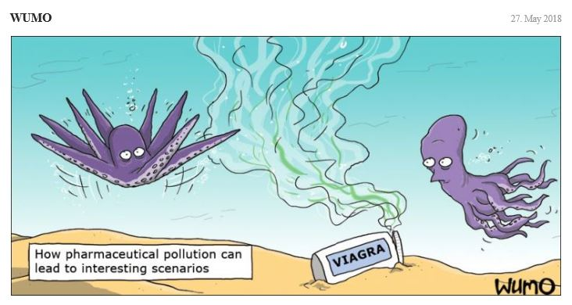
How do Pharmaceuticals get into the Environment?
Purposeful disposal to sink or toilet
  Both public sewer systems and septic systems (pumped and hauled) end up at wastewater treatment plants
Purposeful disposal to trash
Showering/bathing/washing hands of medications applied externally
Pass-through of medications into urine containing 10 – 90 % of ingested medications

Slide 10
How to reduce the amount of pharmaceuticals in the environment
Education of public to dispose of medications properly
  Take unused/unwanted medications to Drug Take Back events for disposal, or dispose of in an authorized collection box. Remove your identification information and address from the container. Collected drugs are ultimately incinerated.
  Trash disposal: English Spanish German Chinese
    http://www.deq.virginia.gov/Programs/Water/PermittingCompliance/PollutionDischargeElimination/Microconstituents.aspx
  Where possible, reduce the amount of medications and nutraceuticals (dietary supplements) ingested
    Only take medications that are appropriate for the illness/condition
    Do not take medications longer than necessary or as directed
    Have your doctor review all of the medications and supplements that you take to make sure combinations won’t be a problem

Slide 11
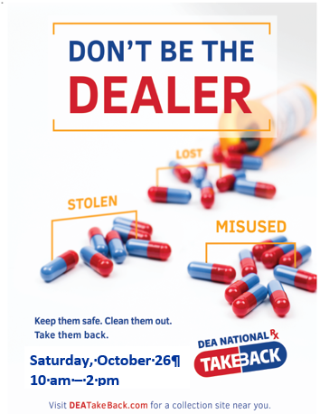
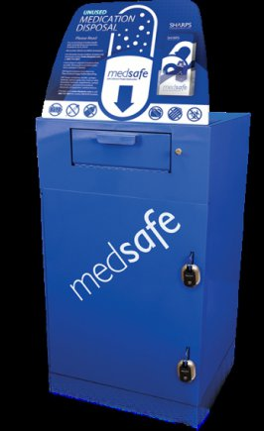

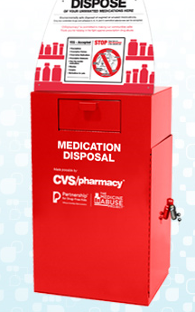
Drug Disposal Options
Drug collection boxes are available at participating police stations and many pharmacies
2019
https://takebackday.dea.gov/

Slide 12
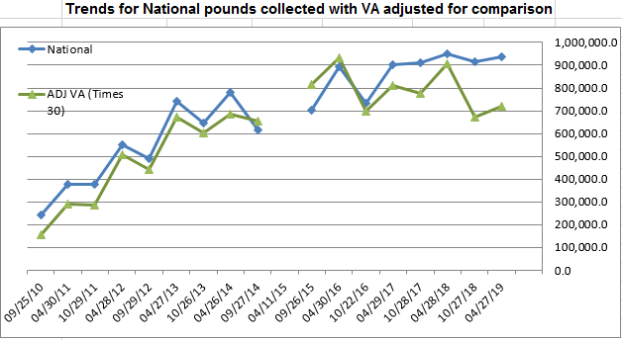
Total pounds collected to date
Nationally –10,878,950 Virginia – 354,012
Interesting trend – Spring collections higher than fall
Click on icon to see how all the states did with the April 2019 Drug Take Back event
Notes:
https://takebackday.dea.gov/sites/default/files/NTBI%2017%20Totals-April2019.pdf
Slides showing # law enforcement participation, pounds collected per state, and amount collected at April 2019 event per state

Slide 13
FDA Guidance on Drug Disposal
In 2007, the FDA advised that 13 drugs be flushed down the toilet instead of thrown in the trash
In January 2012, the FDA advised that 32 drugs be flushed down the toilet instead of thrown in the trash
In November 2013, the FDA advised that 36 drugs be flushed instead of trashed
In April 2016, the FDA advised that 45 drugs be flushed instead of thrown in the trash
April 2018, the FDA posted a list of 49 drugs to be flushed.
From Don McLean’s song “Vincent” –
“They would not listen, they're not listening still.
Perhaps they never will…”
FDA list of Drugs to flush
Notes:
http://www.nacwa.org/docs/default-source/clean-water-current-pdf/22-jan-16/2016-01-22fda-letter-(letter).pdf
https://www.nacwa.org/news-publications/clean-water-current-archives/clean-water-current/2019/03/05/nacwa-hosts-discussion-on-fda-pharmaceutical-flush-list
https://www.fda.gov/Drugs/ResourcesForYou/Consumers/BuyingUsingMedicineSafely/EnsuringSafeUseofMedicine/SafeDisposalofMedicines/ucm186187.htm
https://cfpub.epa.gov/si/si_public_record_report.cfm?direntryid=312892&keyword=ecosystems&subject=ecosystems%20research&showcriteria=2&datebeginpublishedpresented=11/04/2011&dateendpublishedpresented=11/04/2016&sortby=pubdateyear&
https://www.epa.gov/water-research/risks-aquatic-organisms-posed-human-pharmaceutical-use
Fascinating video of mutating bacteria
https://www.wired.com/2016/09/gorgeous-unsettling-video-evolution-action/

Slide 14
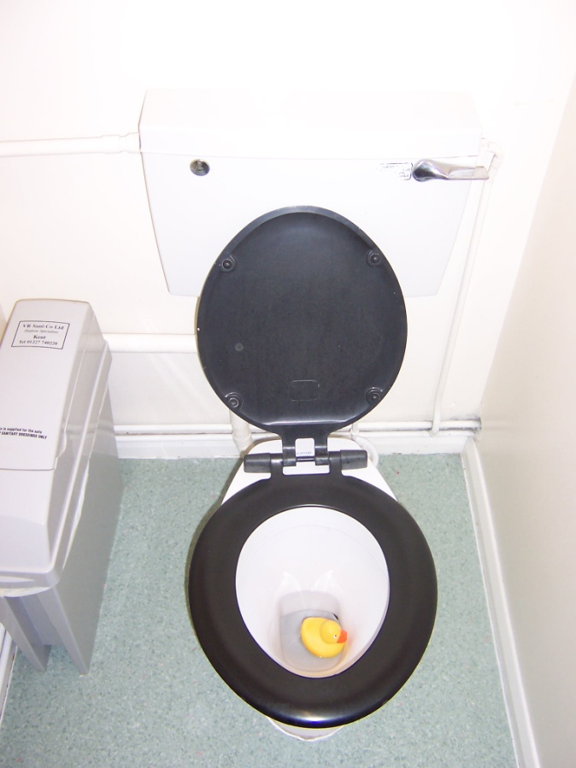
Virginia Guidance
PLEASE
do NOT DISPOSE of
ANY MEDICATIONS
by FLUSHING or washing down the sink!
Don’t take the chance that it could end up in your drinking water!

Slide 15



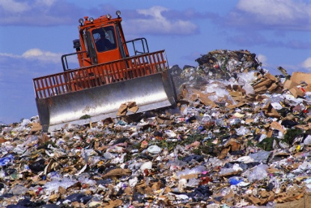


The “circle” of microconstituents
7. Clean water back to you
3. Biosolids to farmland or landfill
1.Sewage to WW Treatment plant
6. Wastewater
discharge
4. Leachate or garbage juice to WW Treatment plant
2. Treated effluent to river
5. Water
intake for Water Treatment Plant
Notes:
http://www.theepochtimes.com/n3/2155348-chemicals-with-unknown-health-effects-in-americas-drinking-water/?utm_expid=21082672-11.b4WAd2xRR0ybC6ydhoAj9w.0&utm_referrer=https%3A%2F%2Fwww.google.com%2F
Chemicals With Unknown Health Effects in America’s Drinking Water

Slide 16
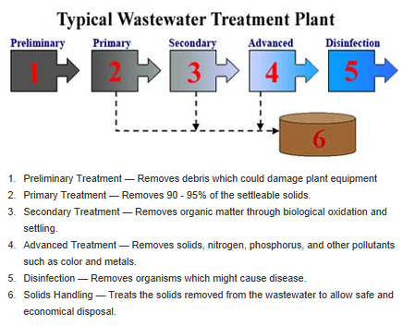
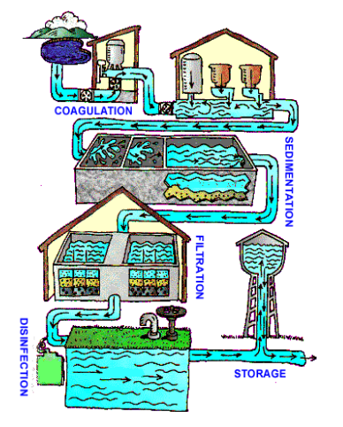
Why don’t Treatment Plants remove microconstituents?
Water Treatment Plant
https://www.youtube.com/watch?v=A2FmNrEmowE
All Treatment Plants have steps 1, 2 and 5.
Most Treatment Plants have steps 1, 2, 3 and 5
Many are adding step 4 to remove nutrients, which helps remove estrogenic compounds
Notes:
See DEQ at deq.Virginia.gov for info on Wastewater Treatment plants
https://www.deq.virginia.gov/Programs/Water/WastewaterAssistanceTraining/WastewaterTreatment.aspx
See Virginia Health Department for info on Water Treatment plants
http://www.vdh.virginia.gov/drinking-water/

Slide 17
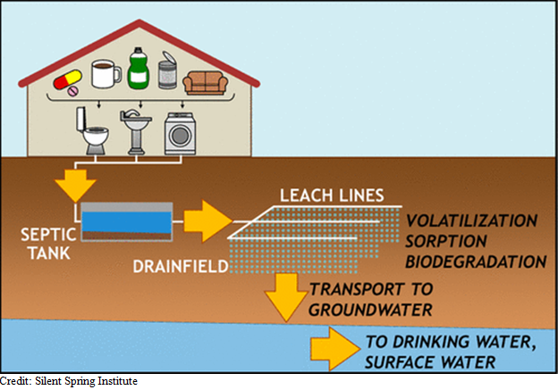

What is the contribution from septic systems?
Can do a decent job removing acetaminophen, caffeine, and alkyphenols (in cleaning products)
Less effective removing TCEP (carcinogenic flame retardant), carbamazepine, and antibiotic sulfamethoxazone
Contaminants can get into groundwater, which may be source of drinking water for household
Users need to avoid household products with harmful ingredients
Well
Casing
Septic systems are a major source of emerging contaminants in drinking water June 26, 2017
Notes:
https://phys.org/news/2017-06-septic-major-source-emerging-contaminants.html
Septic systems are a major source of emerging contaminants in drinking water
June 26, 2017
More information: Laurel A. Schaider et al, Review of Organic Wastewater Compound Concentrations and Removal in Onsite Wastewater Treatment Systems, Environmental Science & Technology (2017). DOI: 10.1021/acs.est.6b04778
http://www.vdh.virginia.gov/environmental-health/onsite-sewage-water-services-updated/

Slide 18
What do you contribute from personal care products (PCPs)?
In 2007, the average person used 9 PPCPs a day. Most recent number is 15 PPCPs per person per day. PPCPs include lotions, powders, soaps, gels, colognes, sprays, toothpaste, make-up, medication, etc.
Think about every product, medication or caffeine/nicotine product you used since you got up.
Read the list of ingredients – remember:
EVERYTHING GOES SOMEWHERE!
Do you need to use all of them?
Can you substitute something less toxic to the environment?
Can you reduce the antibacterial products you use and stay healthy?

Slide 19


Do we need all the drugs and supplements that we take?
Pill to sleep
Pill to stay awake
Pill to give energy
Pill to calm down
Pill to lose weight
Pill to gain weight
Pill to stop reproduction
Pill to encourage fertility
Pill for pain
Pill for ulcer from pain pill
Supplements and vitamins
Would changes in diet, habits, physique help instead of another pill?

Slide 20

Microconstituents are everywhere
ALL municipal sewage, regardless of location, will contain microconstituents. Issue is not unique to any particular municipal area.
Each geographic area will differ only with respect to the types, quantities, and relative abundances of individual contaminants.
Microconstituents can transport by air as well as by water.
Microconstituents are being found in all tested waterways, and are usually ‘present’ in drinking tap water and bottled water.
‘Present’ does not mean they are harmful.

Slide 21
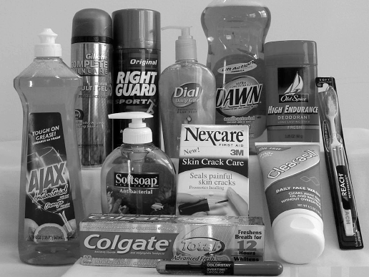
Antibacterial Soaps
Often contain triclosan (liquid soaps) and triclocarban (bar soaps)– synthetic anti-microbial agent and EPA registered pesticide
Not any more effective than soap and water for washing hands
By Sept 6 2017, hand soaps with triclosan and triclocarban for home use should be removed from shelves
Use in health care allowed but discouraged
Most triclosan passes through wastewater treatment plants or ends up in the sludge - very persistent and toxic to marine life.
May contribute to development of mutant bacteria that are antibiotic resistant.
Discourage use in residential and public areas where possible.
Products with triclosan
Notes:
https://s3.amazonaws.com/public-inspection.federalregister.gov/2016-21337.pdf
Accordingly, this final rule covers only OTC consumer antiseptic washes that are intended for use as either a hand wash or a body wash, and does not cover health care antiseptics (80 FR 25166), consumer antiseptic rubs (81 FR 42912), antiseptics identified as "first aid antiseptics" in the 1991 First Aid TFM (56 FR 33644), or antiseptics used by the food industry.
https://www.beyondpesticides.org/programs/antibacterials/triclosan/products-containing-triclosan
https://www.cheatsheet.com/health-fitness/everyday-products-that-contain-triclosan-ingredient-causing-antibiotic-resistance.html/
https://s3.amazonaws.com/public-inspection.federalregister.gov/2016-21337.pdf
https://ehp.niehs.nih.gov/ehp1788/?mc_cid=155344e274&mc_eid=4a6aa19860
In September 2016, the U.S. Food and Drug Administration (FDA) banned nineteen antimicrobial ingredients, including triclosan and triclocarban, in over-the-counter consumer antiseptic wash products based on insufficient evidence demonstrating their safety for long-term daily use and that they reduce the spread of illness and infection.
https://www.technologynetworks.com/applied-sciences/news/excessive-hygiene-promotes-antibiotic-resistance-316731?utm_campaign=NEWSLETTER_TN_Environmental%20Analysis&utm_source=hs_email&utm_medium=email&utm_content=70865191&_hsenc=p2ANqtz-_CJ-IqSEb9hjL4lfcpUHmmKiq2jIMtHCd90wFKfhqwd4thr2IFCgAR1JD2Y_p9d9H33olv5oaqAjj1rKdsqmFRGaEclAIn5B08wO-h98OXA89TME4&_hsmi=70865193

Slide 22
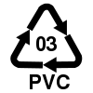

Bis-Phenol A, or BPA
Used in clear, hard plastics (polycarbonate plastic and epoxy resins) since 1957.
All 3’s Some 7’s
Has weak but detectable hormone-like properties
Some states looking at laws to prohibit BPA from being used in baby bottles and products. Some manufacturers making substitutions now.
Removal of BPA for food and drink applications is difficult. Replacement product must be corrosion resistant, withstand high temps used for sterilization and processing, and be chemically compatible with foods, and not add odor or taste.
Reduce exposure by using glass baby bottles, stainless water bottles, food products not in cans.
Notes:
http://healthland.time.com/2012/02/24/study-bpa-may-be-linked-with-heart-disease/
http://www.sciencenews.org/view/generic/id/338202/title/BPA_fosters_diabetes-promoting_changes
http://www.columbiamissourian.com/stories/2012/01/31/mus-frederick-vom-saal-wants-fda-ban-bpa-endocrine-disruptors/

Slide 23
BP-A sources
Canned foods and drinks
Reusable water bottles (Polycarbonate plastic #7, or “PC”)
  Note: Most water and sodas are in flexible, clear plastic bottles made of polyethylene terephthalate, or PET – no BPA.
  Plastics with #1, 2, 4, or 5 do not contain BPA either
Canned sodas and beer
Fast food, particularly burgers
Carbonless register receipts – BPA absorbed through skin, inhaled, or ingested

Slide 24
BP-A and the 50+ “relatives” - BPS, BPF, BPAF, BPZ, BPP, BHPF, and the list goes on
BP-A can be substituted with BPS (bisphenol-S) or BHPF (Fluorene-9-bisphenol) – no real difference in toxicity
Public Health term: “Regrettable substitution” – replacement of one harmful chemical by another possibly equally or more harmful chemical
Endocrine disruptors – affect fertility in men and women, can affect growth and development, cause obesity, diabetes
Notes:
https://www.sciencemag.org/news/2018/09/bpa-substitutes-may-be-just-bad-popular-consumer-plastic
https://www.nationalgeographic.com/science/2018/09/news-BPA-free-plastic-safety-chemicals-health/

Slide 25
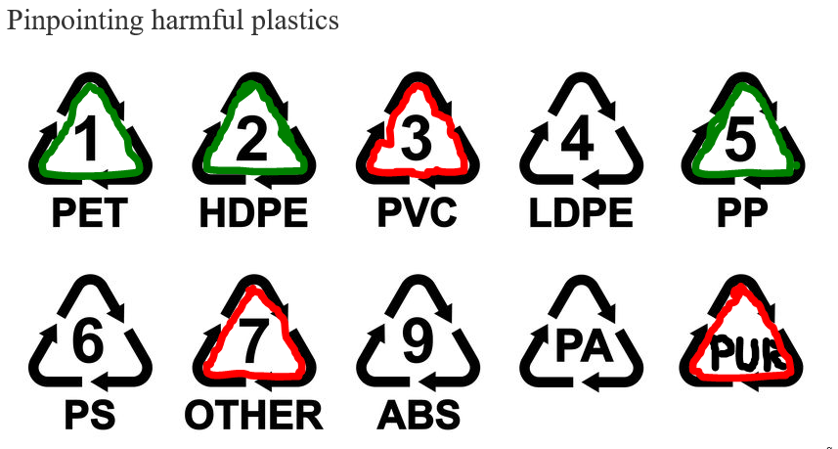
Plastic recycling hints
#3, PVC and PUR – polyurethane are the most toxic of the plastics.
#7 is next worst, since the components are unknown
Only recycle #1, #2, or #5 plastics
Trash black plastic – made from recycled electronic waste. It can’t be recycled again.
Notes:
https://www.mnn.com/lifestyle/responsible-living/stories/chemicals-consumer-plastics-dangerous-confusing?utm_source=Weekly+Newsletter&utm_campaign=6a319fe97a-RSS_EMAIL_CAMPAIGN_FRI0920_2019&utm_medium=email&utm_term=0_fcbff2e256-6a319fe97a-42469305
https://www.wbur.org/hereandnow/2019/09/20/how-to-recycle-plastic
Exposing The Myth Of Plastic Recycling: Why A Majority Is Burned Or Thrown In A Landfill10

Slide 26

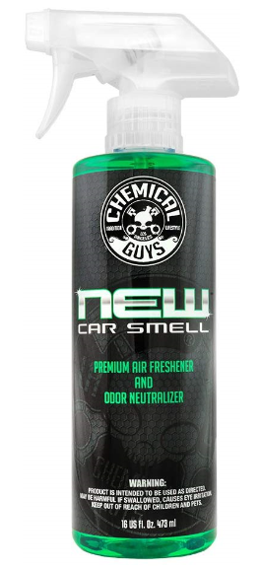
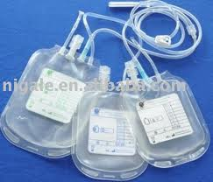

Phthalate – the everywhere chemical!
  Phthalates are a group of chemicals used in:
    soft plastic toys for babies, pets, adults
    vinyl flooring and wall covering
    “new car smell”
    detergents
    lubricating oils
    food packaging
    pharmaceuticals
    blood bags and tubing
    in about 75% of personal care products
  such as cosmetics, fragrances, nail polish,
  hair sprays, soaps, and shampoos.
Notes:
https://www.studyfinds.org/chronic-disease-phthalates-chemicals-men/
Common Household Chemicals Linked To Chronic Disease In Men, Study Finds
“We found that the prevalence of cardiovascular disease, type-2 diabetes and high blood pressure increased among those men with higher phthalate levels,” says Shi, an associate professor at the Adelaide Medical School and the Freemasons Foundation Centre for Men’s Health, in a university press release.
“Importantly, while 82% of the men we tested were overweight or obese – conditions known to be associated with chronic diseases – when we adjusted for this in our study, the significant association between high levels of phthalates and disease was not substantially altered,” adds Shi.
Previous research found that men who frequently ate processed foods, drank sodas, and consumed fewer fruits and vegetables showed higher levels phthalates.
New car smell - "The smell is mostly organic compounds in the vehicle off-gassing. Anything that is vinyl or plastic—the foam lamination on the seat surface, the plastic on the dash or on the door panel—it's the volatile organic compounds (VOCs) coming out of them that causes that smell."
https://www.ncbi.nlm.nih.gov/pmc/articles/PMC4708138/

Slide 27
Phthalates and Human Health
Exposure is through
  Ingestion of food or drink that is in containers containing phthalates
  Inhalation of dust from items containing phthalates
  Skin contact with products made with phthalates
Once in the body, they are converted into metabolites that exit in urine
Women have higher levels of phthalates than men
May affect reproduction or development (endocrine disruptor)
Wash hands well after handling
Avoid products with phthalates where possible
Notes:
https://toxtown.nlm.nih.gov/chemicals-and-contaminants/phthalates#what-are-they

Slide 28
Phthalates
Alters development of reproductive tract, mostly with males – can cause deformity and affect fertility – possible carcinogen. Exposure during fetal development and puberty can help cause an array of complications like genital birth defects, infertility, asthma, and lower IQ
Correlation of higher levels of phthalates with cardiovascular disease, type-2 diabetes, and high blood pressure for males
DEHP - diethylhexyl phthalate is a plasticizer used to soften PVC (EU prohibits DEHP at levels greater than 0.1% by weight) https://www.atsdr.cdc.gov/toxfaqs/tf.asp?id=377&tid=65
Used in IV bags, tubing, blood collection machines. Red Cross is buying some DEHP-free equipment with attrition. For DEHP free equipment sources http://www.noharm.org/
Blood bags with DEHP should not be used with infants or children with compromised immunities
FDA urges alternatives, like ethylene vinyl acetate (EVA) bags which are available except for packed red blood cells
Notes:
http://www.noharm.org/europe/issues/toxins/pvc_phthalates/policies.php
Advocacy group – Health Care Without Harm supports/lists hospitals who are DEHP free www.noharm.org
http://cen.acs.org/articles/95/i26/European-Union-further-restricts-four.html
Volume 95 Issue 26 | p. 15 | News of The Week
Issue Date: June 26, 2017
European Union further restricts four phthalates
http://www.environmentalhealthnews.org/ehs/news/2017/march/pregnant-women2019s-sex-hormones-waver-with-phthalate-exposure
Pregnant women’s sex hormones waver with phthalate exposure
Women exposed to certain chemicals in flooring and food packaging early in pregnancy are more likely to have decreased free testosterone—hormones vital for fetal growth, according to a new study.
Estrogen and testosterone drive a fetus’ genital development the first five to 18 weeks of a pregnancy. Altered levels of the sex hormones can lead to abnormalities in a baby’s genitals. While the study doesn’t prove phthalates in pregnant women lead to genital problems in babies, it suggests that the ubiquitous chemicals may impact fetal growth.
https://gizmodo.com/many-restaurant-meals-come-with-a-side-of-hormone-disru-1824159127

Slide 29
Phthalate reductions/removals
Some manufacturers taking phthalates out of products due to customer complaints: Avon, Johnson & Johnson, S.C. Johnson, Estee Lauder, Revlon, Unilever, Disney.
Check here to see if phthalates are in products: http://www.ewg.org/skindeep/
Phthalates Action Plan Summary. US Environmental Protection Agency. Rulemaking 2012 https://www.epa.gov/sites/production/files/2015-09/documents/phthalates_actionplan_revised_2012-03-14.pdf
DEHP is tested for at public water supplies and regulated under the Safe Drinking Water Act
Notes:
Https://www.epa.gov/assessing-and-managing-chemicals-under-tsca/risk-management-phthalates
https://www.cdc.gov/biomonitoring/Phthalates_FactSheet.html
https://www.hindawi.com/journals/tswj/2012/615068/
https://www.niehs.nih.gov/research/supported/assets/docs/j_q/phthalates_the_everywhere_chemical_handout_508.pdf
DEHP - https://www.atsdr.cdc.gov/toxfaqs/tf.asp?id=377&tid=65

Slide 30
PFAs, per- and polyfluroalkyl substances
EPA health advisory of 0.07 µg/l – no plans to change the advisory. No MCL (maximum contaminant level) for drinking water, not listed as a haz waste, with CERCLA or RCRA.
https://www.amwa.net/article/epa-outlines-path-forward-pfas
Some states adopting more stringent endpoints. See IRTC (Interstate Technology and Regulatory Council) website - https://pfas-1.itrcweb.org/fact-sheets/
Table 4-1 presents the available PFAS water values, Table 4-2 has soil values established by the USEPA, each pertinent state, or country (Australia, Canada and Western European countries)
Table 5-1 summarizes the differences in the PFOA values, Table 5-2 summarizes the differences in the PFOS values for drinking water in the United States.
Notes:
https://pfas-1.itrcweb.org/fact-sheets/
https://www.propublica.org/article/how-the-epa-and-the-pentagon-downplayed-toxic-pfas-chemicals
EPA Releases Updated PFAS Analytical Method (ASDWA, Nov. 21)
EPA has updated its validated Method 537.1 to test for an additional four PFAS in drinking water, including the GenX chemical, hexafluoropropylene oxide dimer acid.
Health goal for GenX in drinking water could be reduced; EPA accepting public comment on draft toxicity report (NCPolicyWatch, Nov. 19)
The basis for the potential switch is the EPA’s draft report proposing a chronic reference dose for GenX that translates to a health goal of 110 parts per trillion in drinking water.
EPA Publishes Draft PFAS Toxicity Assessments for PFBS and GenX (ASDWA, Nov. 16)
On Wednesday, November 14, 2018, EPA published its Draft PFAS Toxicity Assessments for PFBS and GenX for public comment

Slide 31
PFAS – the “Forever Chemicals
Per- and polyfluroalkyl substances – used to make water-, grease- and stain-repellent coatings
Teflon introduced in 1946, PFOA used by Dupont to make Teflon, PFOS used by 3M to make Scotchgard. Manufacture, use and importation of both effectively banned in the US
DuPont no longer makes or uses PFOA – however, Chemours (spin-off of DuPont) makes a replacement called Gen-X
Exposure can cause
  Testicular, kidney, liver and pancreatic cancer
  Increased cholesterol
  Harmful effect to developing fetus or breastfeeding infant
  Low infant birth weights
  Effects on immune system and thyroid
  Weight gain in humans
PFAS chemicals are persistent - remain in body and environment for decades
Notes:
https://pfas-1.itrcweb.org/fact-sheets/
https://www.propublica.org/article/how-the-epa-and-the-pentagon-downplayed-toxic-pfas-chemicals
EPA Releases Updated PFAS Analytical Method (ASDWA, Nov. 21)
EPA has updated its validated Method 537.1 to test for an additional four PFAS in drinking water, including the GenX chemical, hexafluoropropylene oxide dimer acid.
Health goal for GenX in drinking water could be reduced; EPA accepting public comment on draft toxicity report (NCPolicyWatch, Nov. 19)
The basis for the potential switch is the EPA’s draft report proposing a chronic reference dose for GenX that translates to a health goal of 110 parts per trillion in drinking water.
EPA Publishes Draft PFAS Toxicity Assessments for PFBS and GenX (ASDWA, Nov. 16)
On Wednesday, November 14, 2018, EPA published its Draft PFAS Toxicity Assessments for PFBS and GenX for public comment
EPA Allowed Companies to Make 40 New PFAS Chemicals Despite Serious Risks - https://theintercept.com/2019/09/19/epa-new-pfas-chemicals/

Slide 32
Products containing PFAS or PFOS
Some grease-resistant paper, fast food containers/wrappers, microwave popcorn bags, pizza boxes, and candy wrappers
Nonstick cookware
Stain resistant coatings used on carpets, upholstery, and other fabrics
Water resistant clothing
Cleaning products
Personal care products (shampoo, dental floss) and cosmetics (nail polish, eye makeup)
Paints, varnishes, and sealants
Firefighter turnout gear, firefighting foams
Notes:
https://www.atsdr.cdc.gov/pfas/pfas-exposure.html
https://www.cbsnews.com/news/firefighters-battle-occupational-cancer/
https://www.nbcboston.com/news/local/Chemical-in-Firefighter-Turnout-Gear-Eyed-As-Potential-Cancer-Agent-494194661.html
https://ensia.com/features/agricultural-waste/
https://www.globalcitizen.org/en/content/mushroom-fungi-packaging-ikea-decompose-ecovative/?fbclid=IwAR2YzJhzKJ9VheD3cHGzD1rv1alzjtxB5sBgA4uhzmJ_dboNe1vqIeMarMA

Slide 33
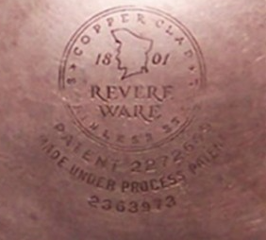
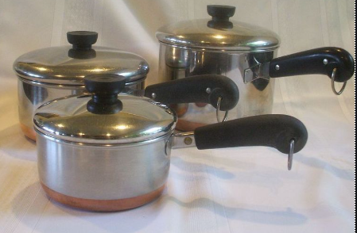
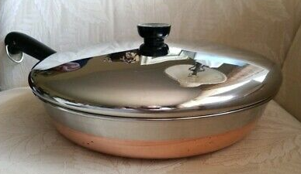
Oldies but goodies – and NO PFOA!
Best if pans were made 1939-1968
Newer Revere Ware does not have a circle or reference to a patent

Slide 34
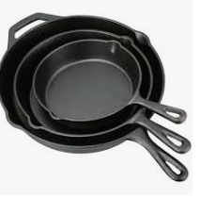
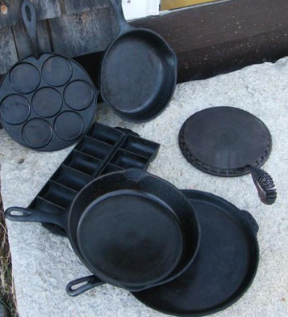
Cast Iron Cookware – No PFOA!

Slide 35
PFAS Exposure Routes
Drinking contaminated municipal water or private well water
Eating fish caught from water contaminated by PFAS (PFOS, in particular)
Accidentally swallowing contaminated soil or dust
Eating food that was packaged in material that contains PFAS
Using some consumer products such as non-stick cookware, stain resistant carpeting, and water repellant clothing.
Note: Only small amount PFAs can get through skin. Showering, bathing, washing dishes should not increase exposure.
Notes:
https://www.atsdr.cdc.gov/pfas/pfas-exposure.html
https://www.mnn.com/food/healthy-eating/questions/whats-the-safest-cookware

Slide 36
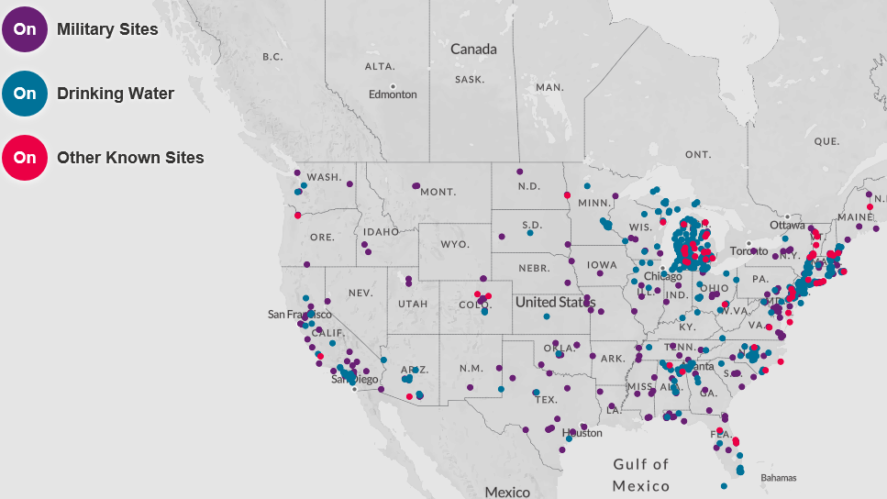
PFAS Contamination in the USA
DOD report on military bases with PFAs and PFOS issues – https://partner-mco-archive.s3.amazonaws.com/client_files/1524589484.pdf
Virginia - Langley-Ft. Eustis, NAS Oceana NALF Fentress, Norfolk Navy Base
Notes:
https://theintercept.com/2018/10/06/dupont-pfas-chemicals-lawsuit/-https://www.nbcboston.com/news/local/Chemical-in-Firefighter-Turnout-Gear-Eyed-As-Potential-Cancer-Agent-494194661.html
https://www.militarytimes.com/news/your-military/2018/06/08/dod-explains-whats-being-done-about-water-contamination-on-bases/
Interactive map showing PFAS contamination in the US:
https://www.ewg.org/interactive-maps/2019_pfas_contamination/map/?_gl=1*7348rl*_gcl_aw*R0NMLjE1Njk0MjEzNjcuRUFJYUlRb2JDaE1JaGNqT2o1VHM1QUlWRFhpR0NoMFJNZ2s4RUFBWUFTQUFFZ0lPRXZEX0J3RQ..&_ga=2.87681944.1449900007.1569421367-532331371.1568742600&_gac=1.45343760.1569421367.EAIaIQobChMIhcjOj5Ts5AIVDXiGCh0RMgk8EAAYASAAEgIOEvD_BwE

Slide 37

Fire Retardants
PBDEs – Poly-brominated diphenyl ethers (or BDEs), commonly referred to as penta, octa and deca ( i.e. penta-brominated diphenyl ether) considered Persistent Organic Pollutants (POPs)
Used in furniture, carpets, vehicles, electronics - Showing up in sediment, water and air
PBDEs leaching out of products and get in blood – can cause thyroid problems, developmental problems, carcinogenic
Penta and Octa forms have been phased out – deca still used
Organophosphate substitutes (TDCIPP and TPHP) showing up in blood too. May cause fertility problems, and linked to poorer cognitive function in children. tris (1,3-dichloro-2-propyl) phosphate (TDCPP).
New substitute products should be thoroughly tested prior to marketing to make sure that they are safe.
Notes:
http://www.dailymail.co.uk/sciencetech/article-4258126/High-levels-flame-retardants-indoor-cats.html
Indoor cats have high levels of brominated flame retardants in their blood. These chemicals are added to furniture and electronics to prevent them from igniting. They become part of house hold dust and can have negative health effects These flame retardants have been associated with feline hyperthyroidism The researchers say that the results are interesting because small children have similar exposure levels to the chemicals as these cats
Read more: http://www.dailymail.co.uk/sciencetech/article-4258126/High-levels-flame-retardants-indoor-cats.html
http://www.environmentalhealthnews.org/ehs/news/2016/dec/flame-retardants-and-car-seats-still-a-thing
http://www.lcnewschronicle.com/news/4171016-commission-urges-action-toxic-flame-retardant-great-lakes-region
https://community.nfpa.org/community/conference-expo/blog/2016/06/13/toxic-chemical-fire-retardants-discussed-at-nfpa-ce
http://www.northcarolinahealthnews.org/2016/09/23/tutoring-the-textile-industry-on-risky-flame-retardants/
http://www.environmentalhealthnews.org and search for topic of interest.
http://news.xinhuanet.com/english/2017-03/10/c_136117072.htm

Slide 38
Fire retardants
PBDEs are used in cell phones, remote controls, personal computers, computer monitors, textiles, electronics, cabinets and enclosures for electronics, foam cushioning, foam-based packaging materials, upholstery, carpet padding, paint products, and adhesives
Exposure through
  Ingestion – eating contaminated food or water
  Inhalation – breathing air or dust with PBDE emissions
  Skin contact – touching items containing PBDEs
Concerns – endocrine disruptor, may cause liver, thyroid and neurodevelopmental dysfunction. Accumulates in body.
Children and pets have more exposure
Notes:
https://toxtown.nlm.nih.gov/chemicals-and-contaminants/polybrominated-diphenyl-ethers-pbdes

Slide 39

Feeling Blue?
Notes:
https://www.sciencenews.org/article/suds-turn-silver-nanoparticles-clothes-duds
Athletic clothing and hospital gown containing silver for antibacterial purposes lose coating with bleach detergents
http://www.mayoclinic.org/healthy-lifestyle/consumer-health/expert-answers/colloidal-silver/faq-20058061
https://www.purestcolloids.com/blue-man.php
– claims colloidal silver not at fault

Slide 40


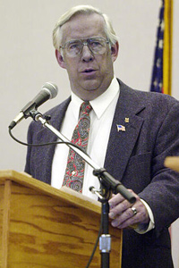

Argyria from silver ingestion
Paul Karason started turning blue 15 years after he began ingesting silver-based prep and colloidal silver to self medicate a skin condition. Stan Jones, bottom right
Argyria (ahr–JIR–e–uh), a blue-gray discoloration of your skin, eyes, internal organs, nails and gums. While argyria doesn't pose a serious health problem, it can be a cosmetic concern because it doesn't go away when you stop taking silver products.
Currently no FDA approved oral OTC or prescription drugs containing silver.
https://nccih.nih.gov/health/silver
Notes:
http://abcnews.go.com/Health/internet-sensation-papa-smurf-dies-blue-people-live/story?id=20368758
http://www.webmd.com/vitamins-supplements/ingredientmono-779-colloidal%20silver.aspx?activeingredientid=779&activeingredientname=colloidal%20silver

Slide 41

Silver as Antibacterial Silver as antibacterial
The Silver Institute promotes silver in medical supplies as biocide, in water purification systems, pools and spas (https://www.silverinstitute.org/site/)
Silver or triclosan treated clothing for “anti-odor” and “anti-bacterial” purposes will release coatings with bleach detergents (~25% after 2 washes, up to 50% with more washes), discharging to sewers → POTWs → state waters. Bacteria mutate to survive, becoming more antibiotic resistant.
The Mayo Clinic – Colloidal silver isn't considered safe or effective for any of the health claims manufacturers make. Silver has no known purpose in the body, nor is it an essential mineral, as some sellers of silver products claim.
3/25/15 EPA requires registration under pesticide law of products containing nanoscale (smaller than 1 micrometer) silver designed to control microbes.
Notes:
https://www.sciencenews.org/article/suds-turn-silver-nanoparticles-clothes-duds
Athletic clothing and hospital gown containing silver for antibacterial purposes lose coating with bleach detergents
http://www.mayoclinic.org/healthy-lifestyle/consumer-health/expert-answers/colloidal-silver/faq-20058061
https://www.purestcolloids.com/blue-man.php
– claims colloidal silver not at fault

Slide 42
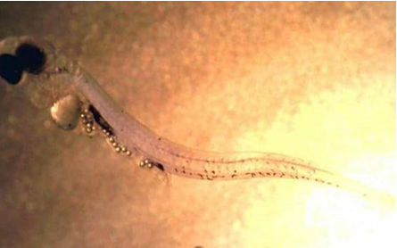
Microbeads
Plastics disintegrate in the oceans and are ingested by aquatic organisms
Many PCPs contained microbeads like
exfoliates, body washes, toothpastes
Seafood eating humans ingest up to
11,000 tiny pieces of plastic every year
Larval perch with plastic beads
2017 – illegal to sell a PCP with plastic
microbeads
Next issue is glitter, small pieces of plastic
Notes:
http://www.telegraph.co.uk/science/2017/01/24/seafood-eaters-ingest-11000-tiny-pieces-plastic-every-year-study/
https://skyoceanrescue.com/
http://storyofstuff.org/plastic-microbeads-ban-the-bead/
https://www.mnn.com/food/healthy-eating/blogs/how-much-plastic-do-you-consume-every-day?utm_source=Weekly+Newsletter&utm_campaign=e4d06372d1-RSS_EMAIL_CAMPAIGN_MON0610_2019&utm_medium=email&utm_term=0_fcbff2e256-e4d06372d1-42469305
https://www.cbc.ca/radio/quirks/april-7-2018-microplastics-contaminate-land-a-four-eyed-lizard-dark-matter-goes-missing-1.4607807/scientists-worry-microplastics-found-on-farmers-fields-could-end-up-in-our-food-1.4607830

Slide 43
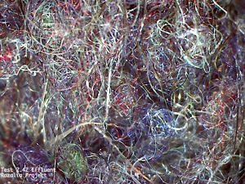
Microplastics and Microfibers
Microfibers are made of plastic and chemical covered non-plastics
Breaking off clothes in the water, discharged through drain water
One fleece jacket could shed 250,000 pieces of fibers/wash
    80
    70 Human hair 70 µ wide
60
50
40 Naked eye can see 40 µ
    30
    20
    10 Red blood cell is 8 µ
    0 Microfibers are 3-60 µ
Photo shows a 3 mm (0.1 in) section of microfibers filtered from drain water of standard load of laundry magnified 120 X
Notes:
http://www.telegraph.co.uk/science/2017/01/24/seafood-eaters-ingest-11000-tiny-pieces-plastic-every-year-study/
https://skyoceanrescue.com/
http://storyofstuff.org/plastic-microbeads-ban-the-bead/
http://rozaliaproject.org/stop-microfiber-pollution/
http://time.com/5581326/plastic-particles-in-bottled-water/?fbclid=IwAR0wuzcrVOMKUlBukTpL_62PXT_DbrU2B-fUc64oNyYNUb9rq6ZRu27di40

Slide 44
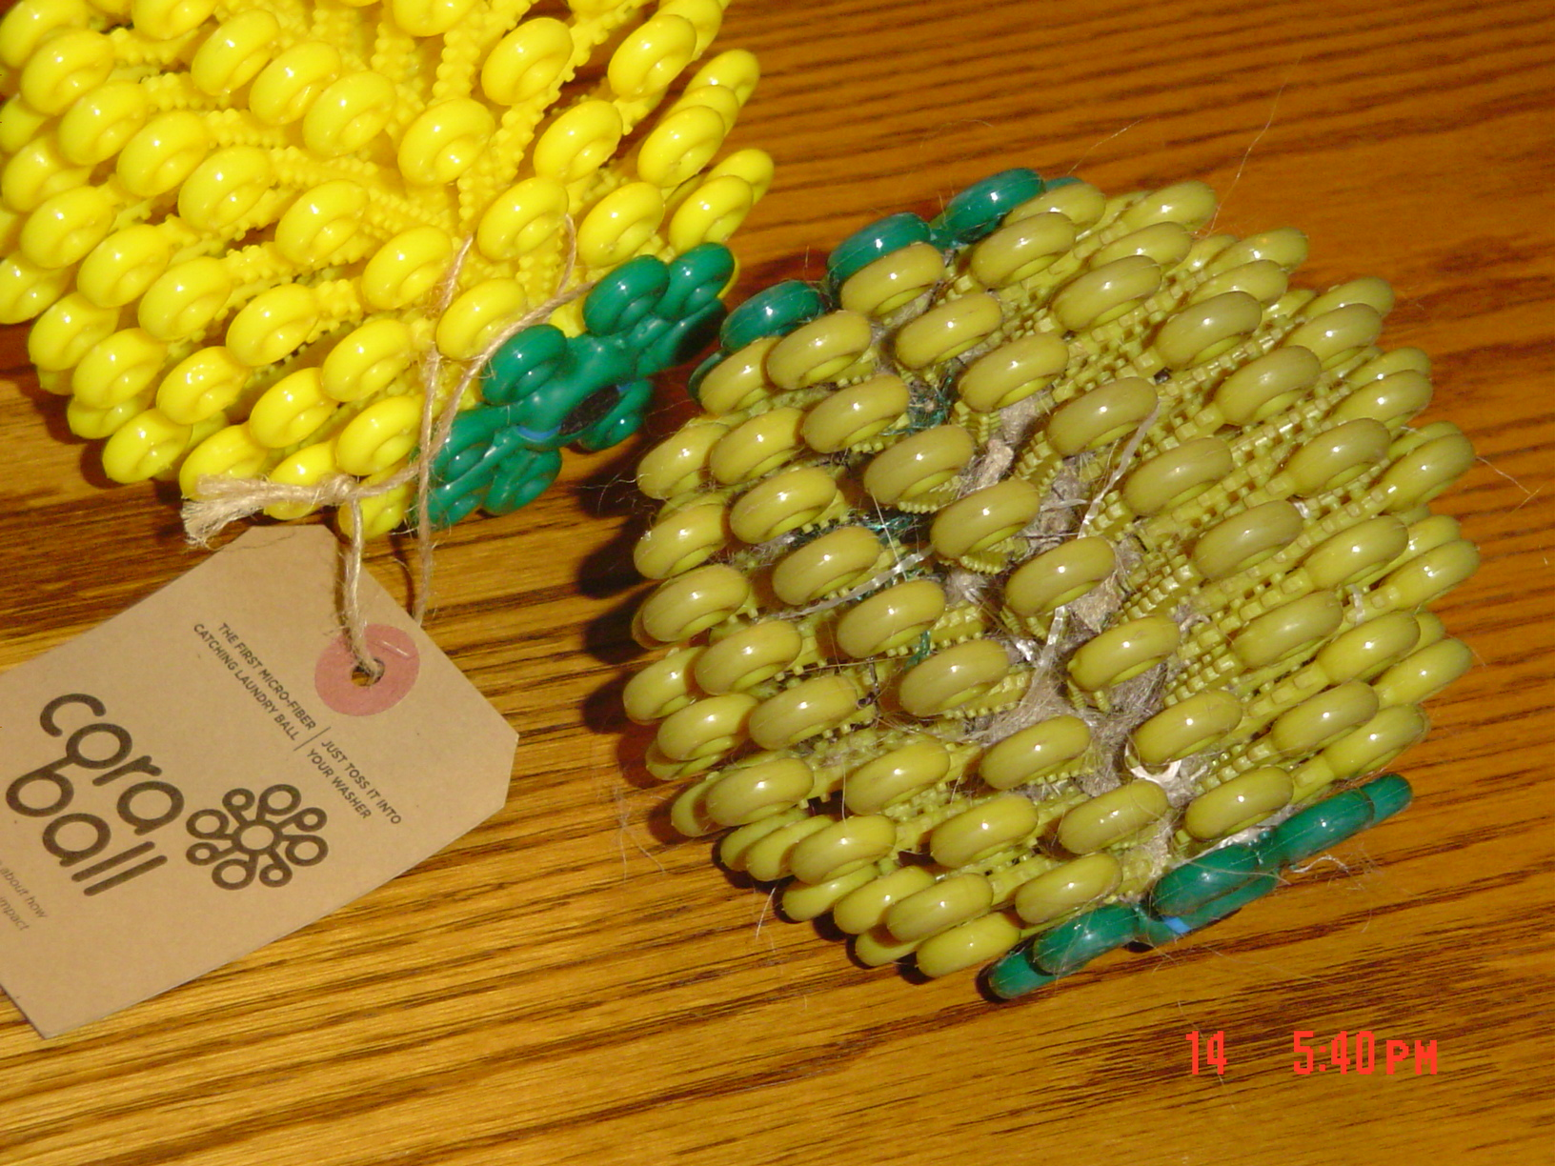

Microplastics and Microfibers
90% of collected samples have microplastics
89% microfibers, 11% plastic fragments
One in 3 shellfish; 1 in 4 fin fish and 67% of all species tested from fish markets in California had microfiber in them
Cows, pigs and chicken are fed fish meal
Drain filters needed
Cora Ball now available
Notes:
http://www.telegraph.co.uk/science/2017/01/24/seafood-eaters-ingest-11000-tiny-pieces-plastic-every-year-study/
https://skyoceanrescue.com/
http://storyofstuff.org/plastic-microbeads-ban-the-bead/
http://rozaliaproject.org/stop-microfiber-pollution/

Slide 45
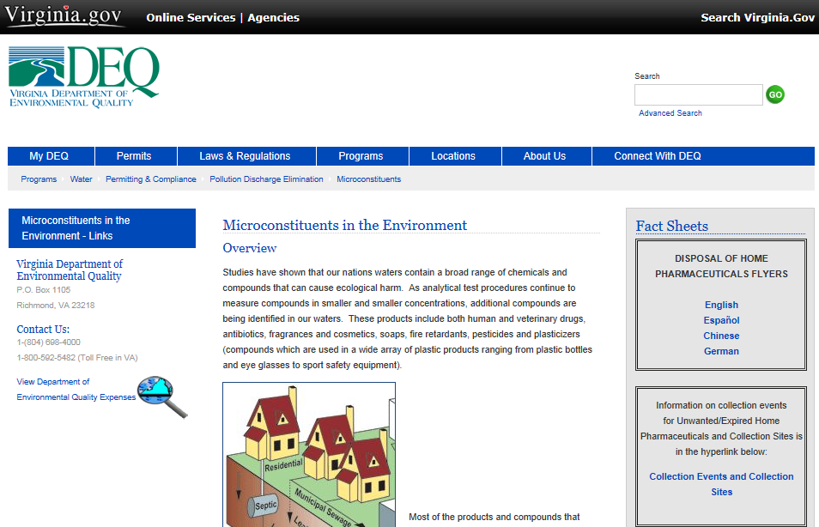
http://www.deq.virginia.gov/programs/water/permittingcompliance/pollutiondischargeelimination/microconstituents.aspx
Notes:
Annie Leonard video series: http://www.storyofstuff.com/
The Story of Electronics, The Story of Stuff, The Story of Cap & Trade, The Story of Bottled Water, etc.
Site to check for news articles on the subject worldwide
http://www.environmentalhealthnews.org/
The Association of State Drinking Water Administrators (ASDWA) www.asdwa.org
Pharmacy waste list server
http://lists.dep.state.fl.us/cgi-bin/mailman/listinfo/pharmwaste
USGS Emerging Contaminant Project site
http://toxics.usgs.gov/regional/emc/
http://toxics.usgs.gov/regional/emc/index.html USGS Emerging Contaminants
Health Care without Harm - http://www.noharm.org
The Poseiden Report – Study on effectiveness of wastewater technologies on PPCPs in WW and DW – May 06
http://poseidon.bafg.de/servlet/is/2884/
WHO Working Group on Pharmaceuticals in Drinking Water http://water.epa.gov/scitech/swguidance/ppcp/who.cfm

