Slide 1
A Primer on Pumps
Shenandoah Valley
December 2, 2015

Slide 2
PUMP CURVES

Slide 3
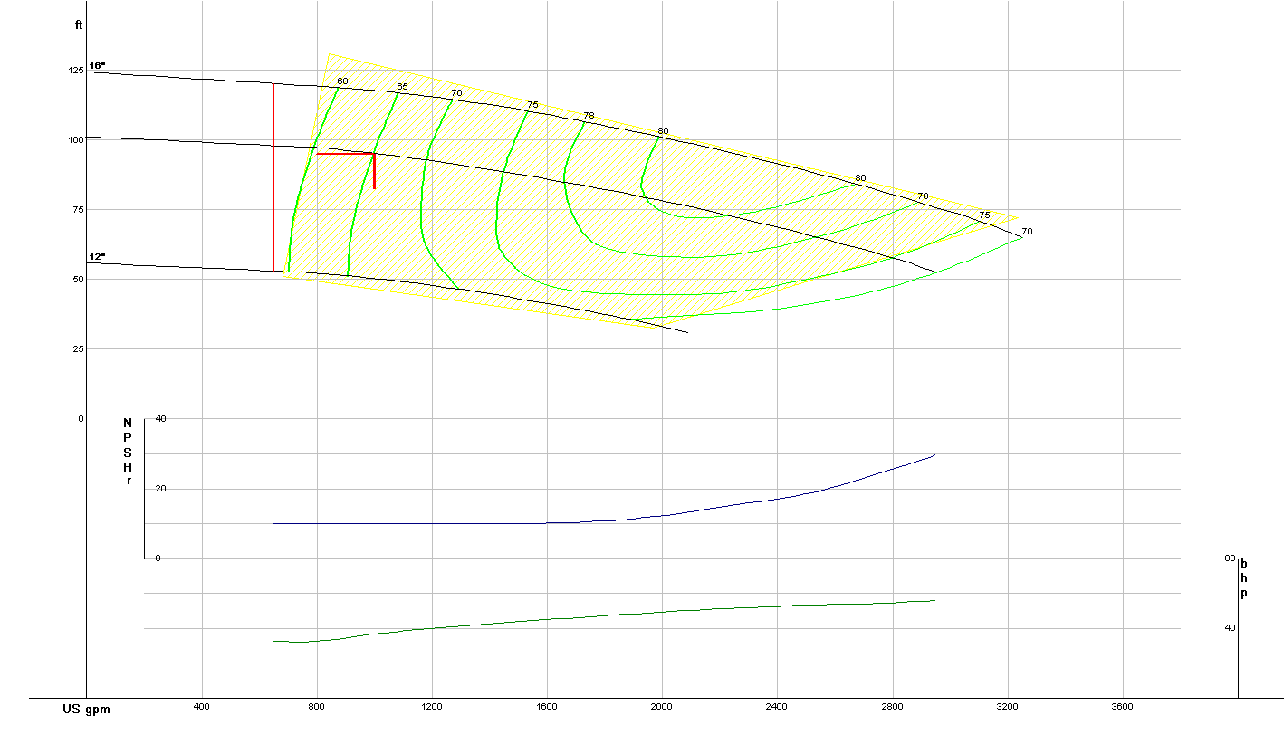
Typical Manufacturer’s Performance Curve
Selection point from pump mfr’s software
Max impeller cut
Min impeller cut
Performance curve for selected impeller cut
NPSH3 curve for selected impeller cut Power curve for selected impeller cut

Slide 4
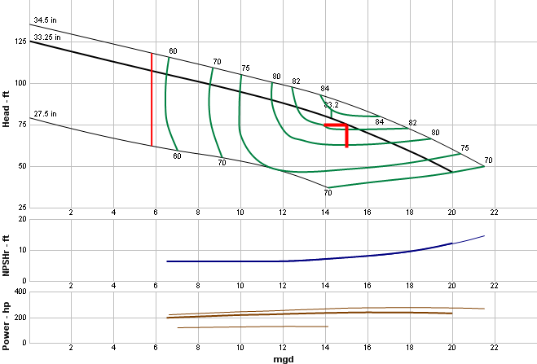
How a Pump Works with System Curves
Intersection of system curve and pump H/Q curve determines operating condition

Slide 5
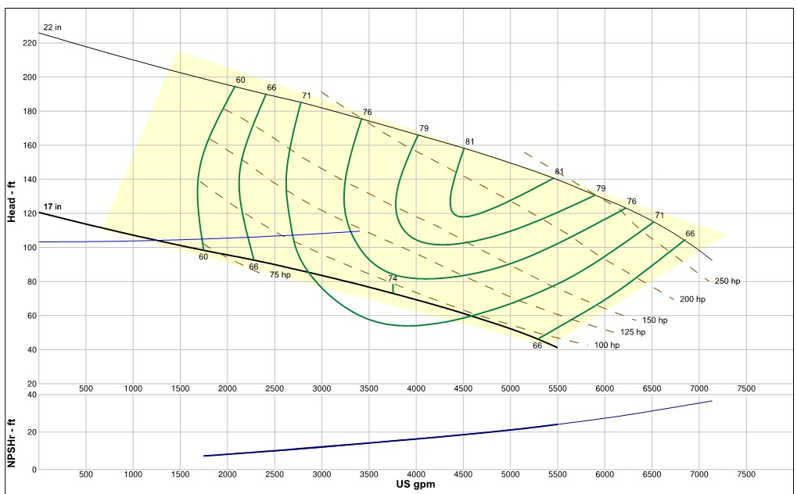
Peak wet weather flow 2300 gpm = 62 %
Best Efficiency Point
Policy
70 % speed proposed typical operation = 24%
NSS = 8080, Ns = 1850

Slide 6
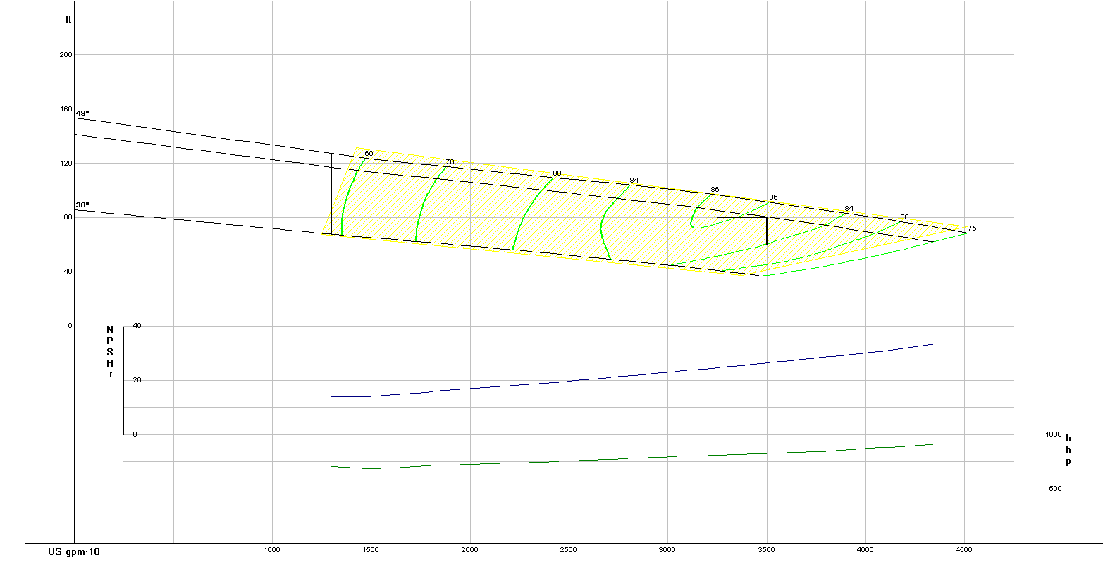










How a Pump Works
Manufacturer’s minimum safe flow
POR**
AOR
70%
AOR
POR
BEP
120%
AOR
AOR
Tread very lightly here
**Limits of POR will depend upon on Ns and Nss

Slide 7
DETERMINE THE PREFERED OPERATING RANGE

Slide 8

NPSH3 and Suction Specific Speed
Suction Specific Speed, Nss
n(Q_{BEP})^{0.5}
NPSH3_{BEP}^{0.75}
Nss = 5,000 – 10,000
Specific Speed - Ns
n(Q_{BEP})^{0.5}
TDH_{BEP}^{0.75}

Slide 9
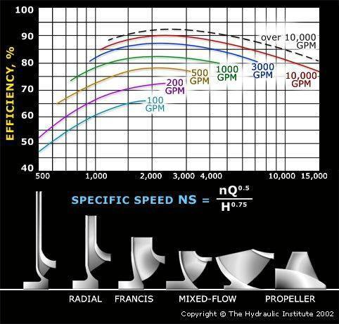
Pump Types – Specific Speed

Slide 10
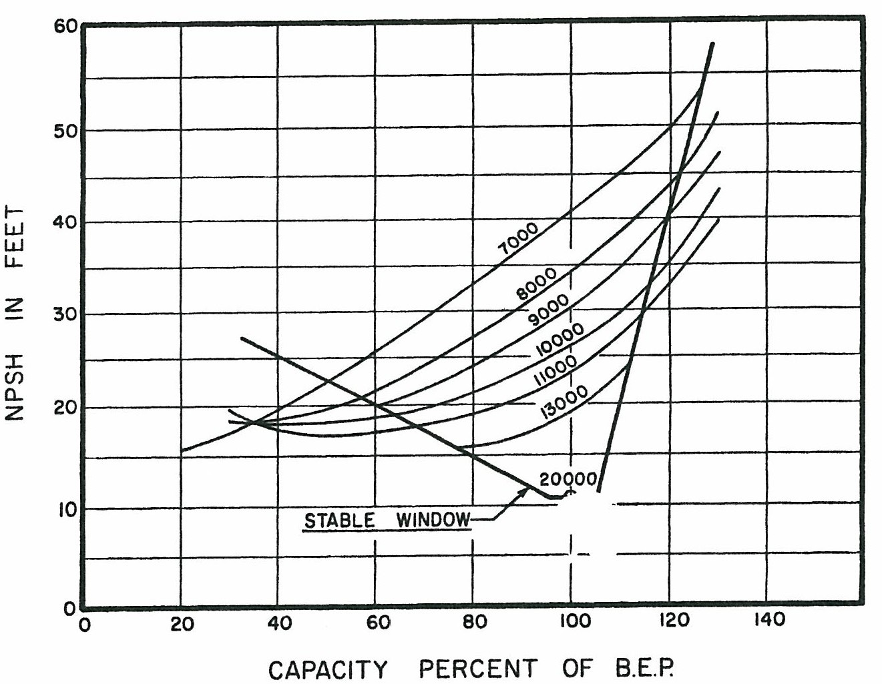
Stability and Suction Specific Speed (Nss)
nss
Source: Centrifugal Pumps/Design and Application, Lobanoff and Ross 1992

Slide 11
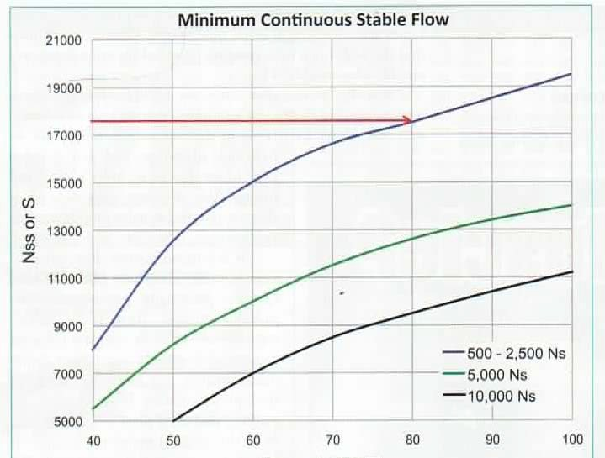
Ns, Nss, Stability and Pump Clogging
10,000 Nss Limit
Volute type
Column type
Source: ‘Suction Specific Speed and Wastewater Pumps’ Dr. J. Evans, Pumps and Systems, Nov. 2011

Slide 12
Principles that Promote Reliability, Efficiency and Reduced Operating Cost
Construction
  Equipment Selection
  Installation Design and Details
  Operational Controls
  Machine health monitoring

Slide 13
Pump Structure

Slide 14
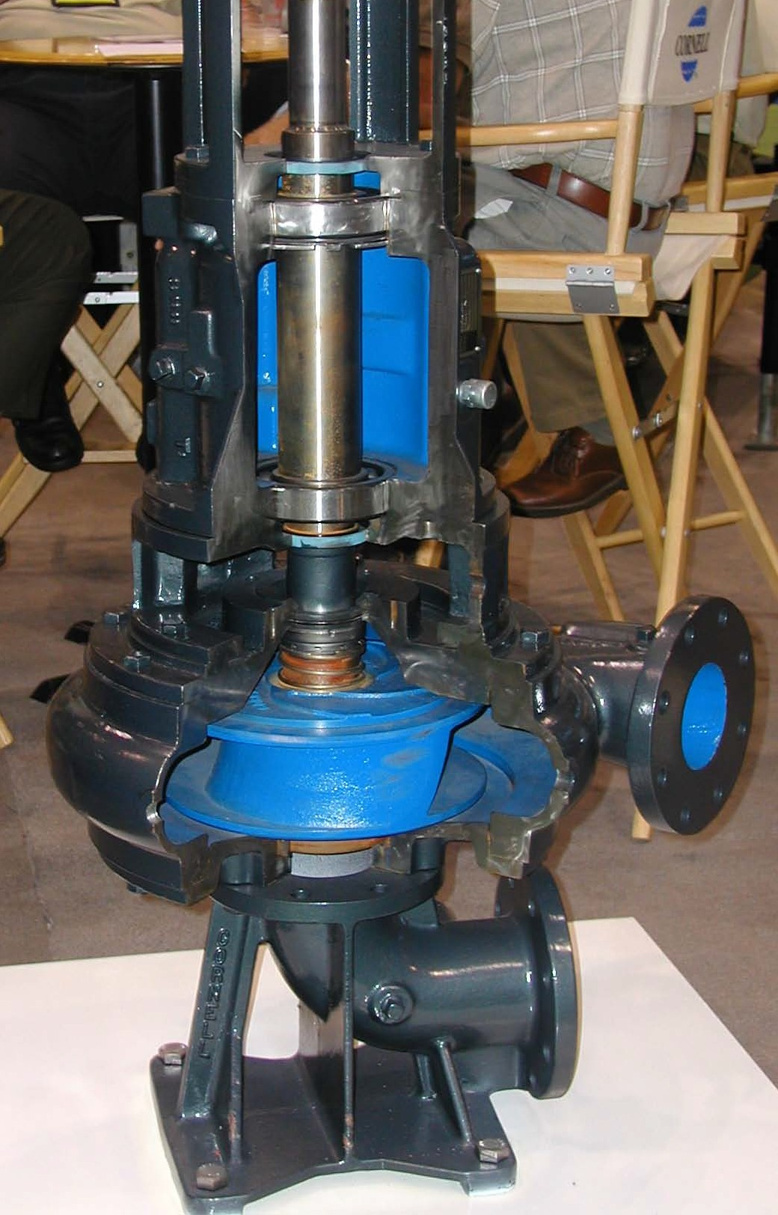
Mechanical Seals: 0.002” Max Deflection
Shaft
Thrust Bearing
Bearing Frame
Radial Bearing
Shaft Seal
Impeller
Radial load imposed
By differential pressure
Casing

Slide 15
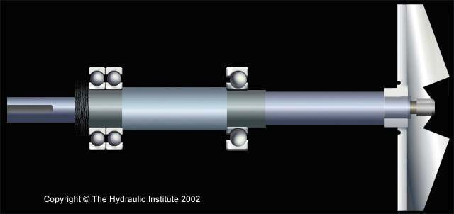

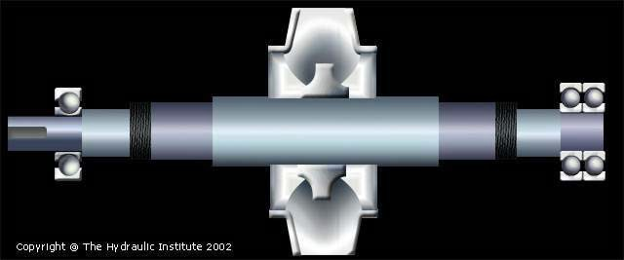
Overhung Shaft
Between Bearings

Slide 16
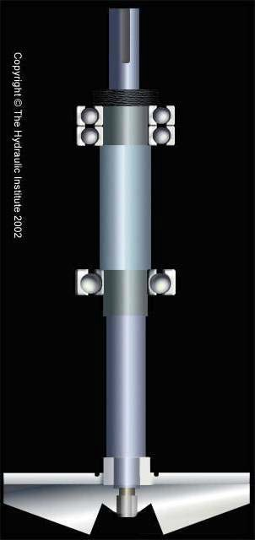
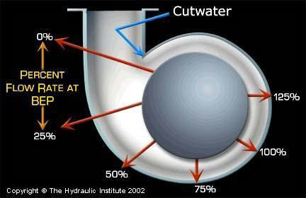














Shaft Seal
BEP
Increasing
Radial thrust
Radial Thrust

Slide 17
Cavitation

Slide 18

Misleading Pump Terminology
Net Positive Suction Head Available (NPSHA)
  The energy in feet of head, adjusted for liquid vapor pressure, in the pumped fluid at the eye of the impeller
Net Positive Suction Head Required, NPSHR,(now NPSH3)
  The energy, in feet of head adjusted for vapor pressure, in the pumped fluid at the eye of the impeller resulting in a 3 percent reduction of developed head for a given flow

Slide 19
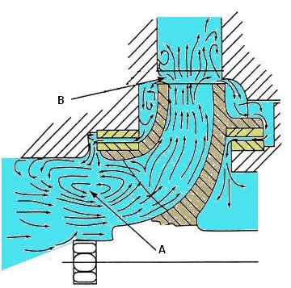
Mechanics of Cavitation – Recirculation
Discharge recirculation
Suction recirculation

Slide 20
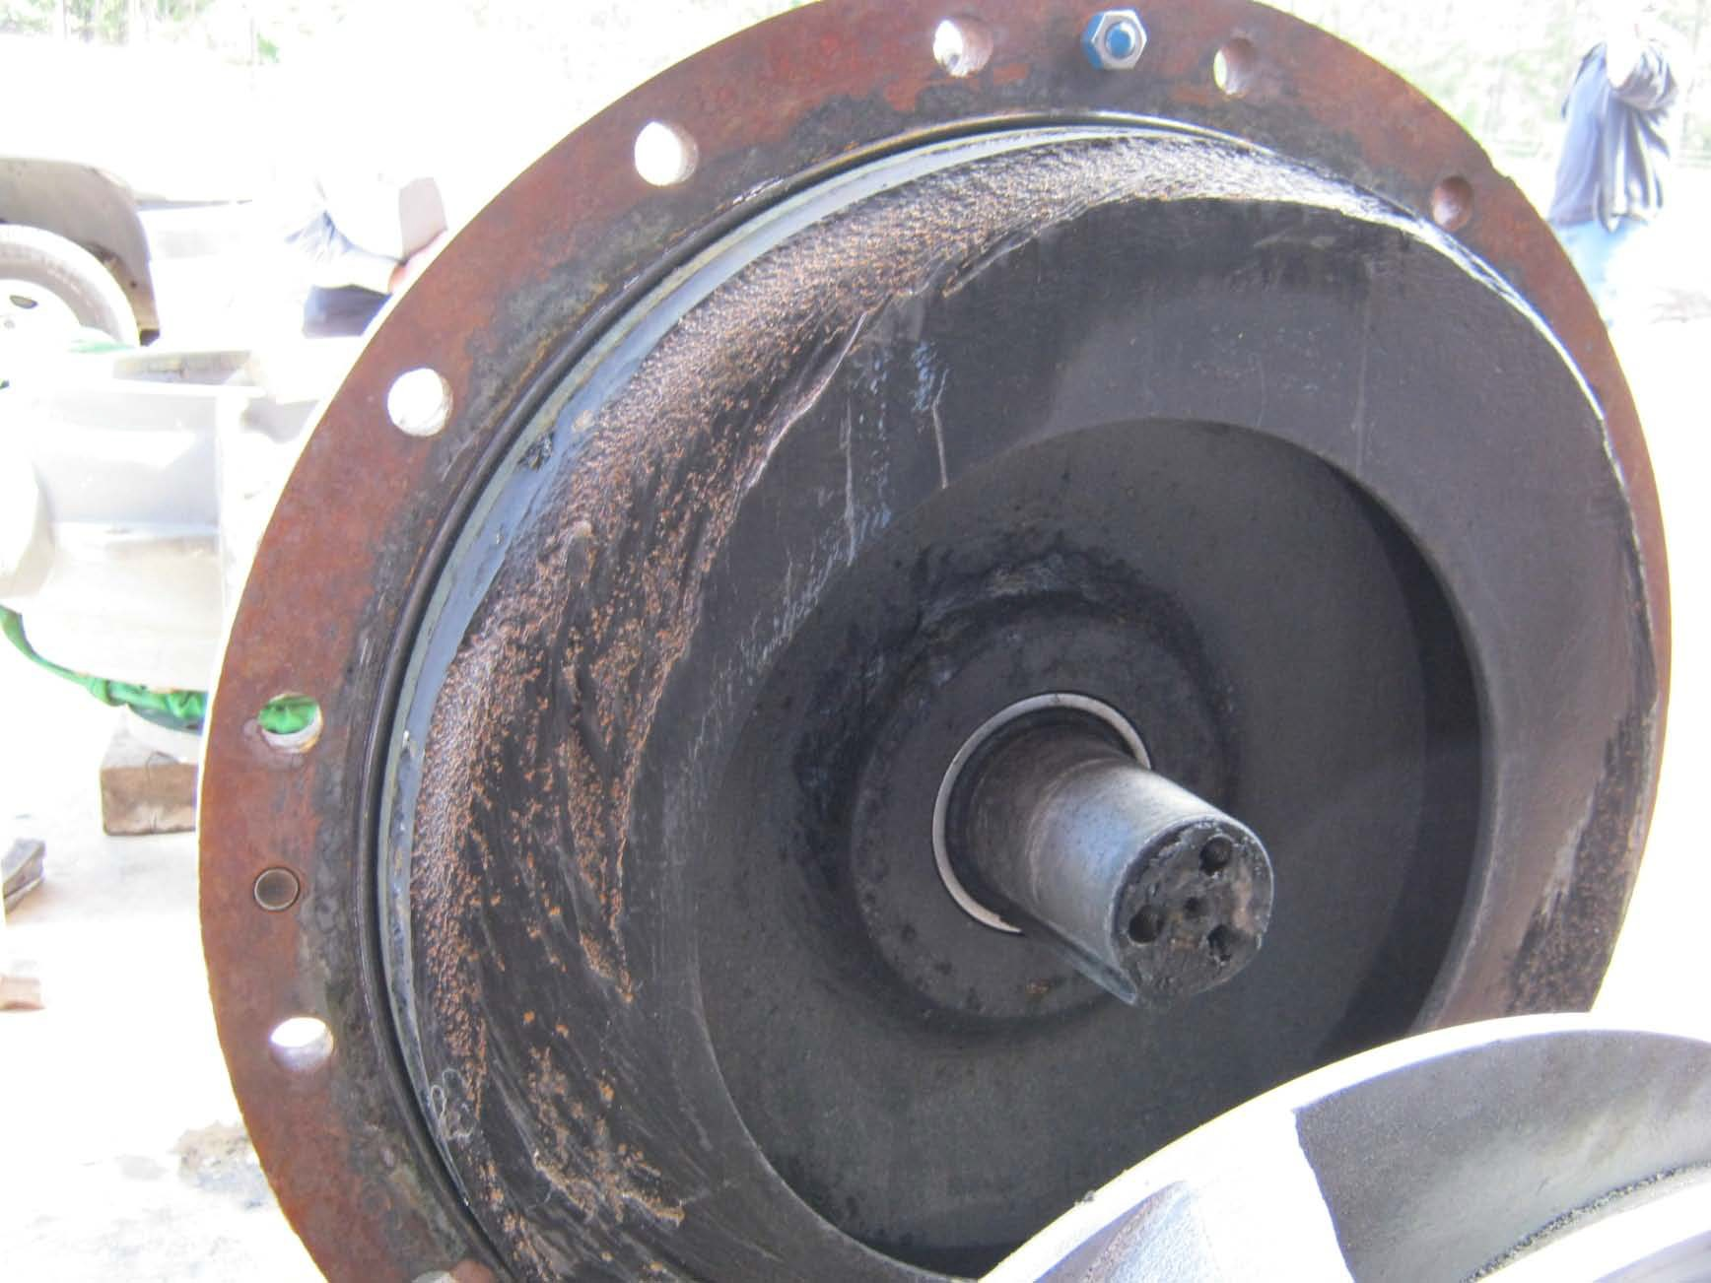
Recirculation Cavitation Damage

Slide 21

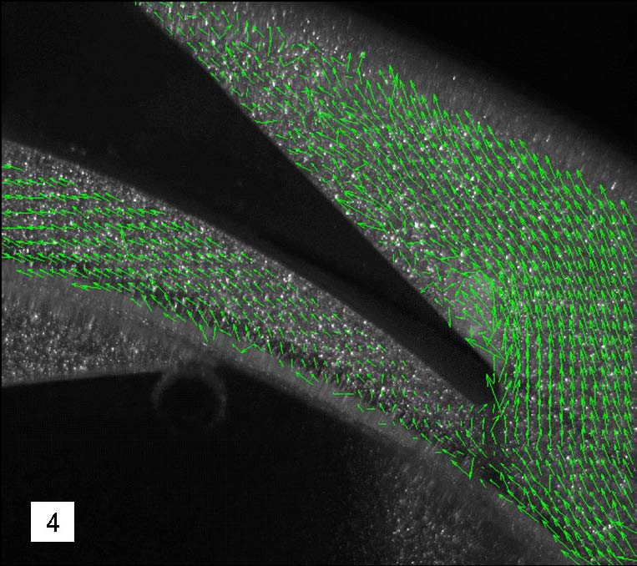
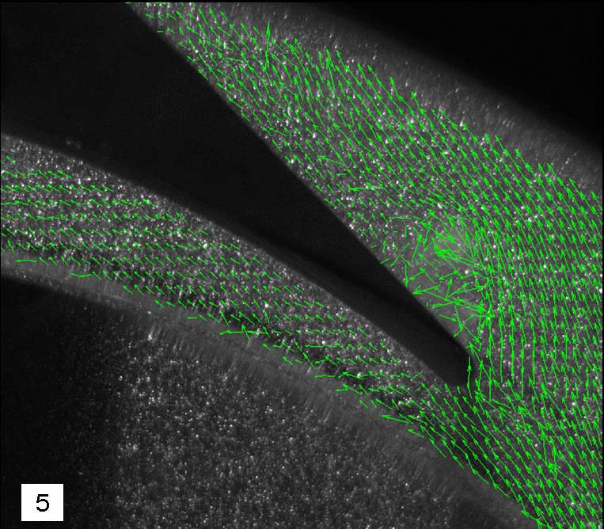
Mechanics of Cavitation – V
Cloud Cavitation Caused by Poor Impeller Vane/Cutwater Angles

Slide 22
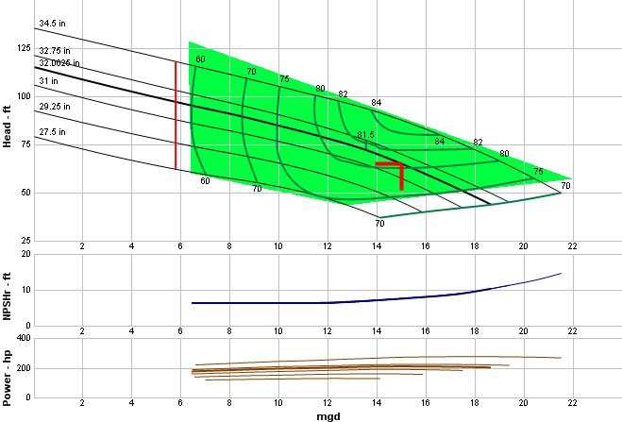
Bad Things Begin to Happen when Operating in the AOR…
Increasing
radial thrust
Increasing
Increasing discharge recirculation
vibration
Increasing suction
recirculation Increasing inlet
Increasing
surging
cavitation
POR

Slide 23














Relationship Between Head, Capacity, NPSHA and Cavitation
NPSHR(3)
NPSHR(3)

Slide 24
Operating Domains for Cavitation
NPSHi/Q
Head
QBEP
Efficiency
NPSH
NPSHr/Q (- 3% H)
Efficiency/Q Head/Q
Flow, Q
Source: “Cavitation: How Does It Happen?”
Dr. Paul Cooper, Pumps and Systems, June 2002, pg 16

Slide 25

















Source: NPSH for Rotodynamic Pumps: a reference guide
Europump, Elsevier Science, Inc., 1999
Incipient cavitation
Q

Slide 26
WET WELLS and Pump Intakes

Slide 27
Sources of Air in Pumped Fluid
Cascade Discharges into Wet Well from Tributary Sewers
Poor Wet Well Design
Pump Inlet Design
Wet Well Level Controls

Slide 28
Air Trivia
Bubble rise rate ≤ 1 ft/second
Pump inlet velocity ≥ 4 ft/second

Slide 29


Effect of Air in Pumped Fluid
Vibration
Loss of Pump Capacity

Slide 30

Features of a Bad Pump Intake
Floor Currents
Rotating Flow
Cascades
High Energy Currents
Unconfined Inlets

Slide 31

Features of a Good Pump Intake
The pumped fluid must approach symmetrically; no changes in direction
No high energy currents
Minimal entrained air
Sufficient NPSH margin
Intake level must be high enough to prime the pump
Sufficient submergence to avoid vortex development
Confined to prevent rotation

Slide 32
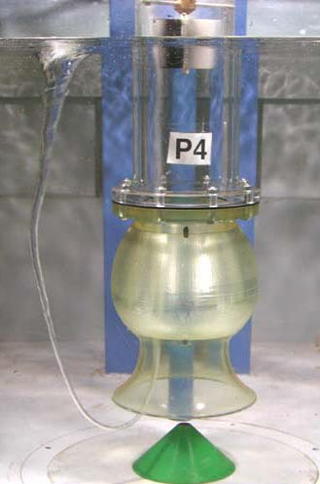
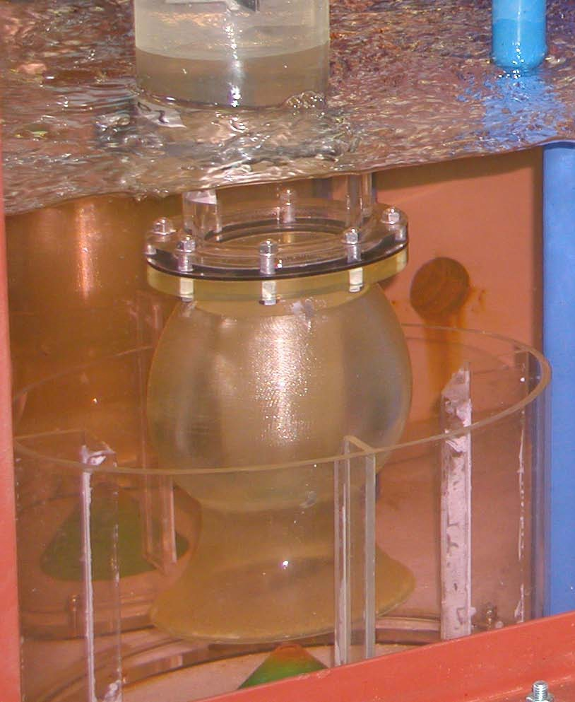
Elimination of Air Core Surface Vortex
Before and After Confined Inlet
Before Modification Modified Intake

Slide 33






Rules for Design of Pump Intakes
No sudden reductions or expansions
Uniform approach conditions 5 diameters upstream from pump connection
No flow disturbing fittings upstream
Uniform velocity distribution at pump connection
Max velocity 8+ft/sec

Slide 34
Traditional Wet Well Configuration
Non-uniform velocities
Swirling
Subsurface and surface vortices

Slide 35
Traditional Wet Well Configuration (cont.)
Intakes
Inlet
Intake s
Intakes
Intakes
Inlet

Slide 36

Confined Inlets
3D
2.5D
22D
0.25D
0.5D
Plan
D
2D
Section

Slide 37
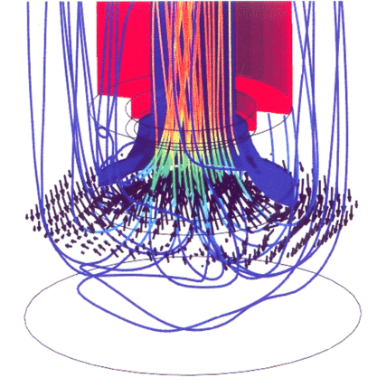
Trench Wet Well Advantages
Confined inlet reduces long- term wear and tear from vibration, cavitation and torque reversals caused by floor currents and vortices
Reduces vortex formation
Even load on pump bearings and seals
No screening necessary in most installations

Slide 38
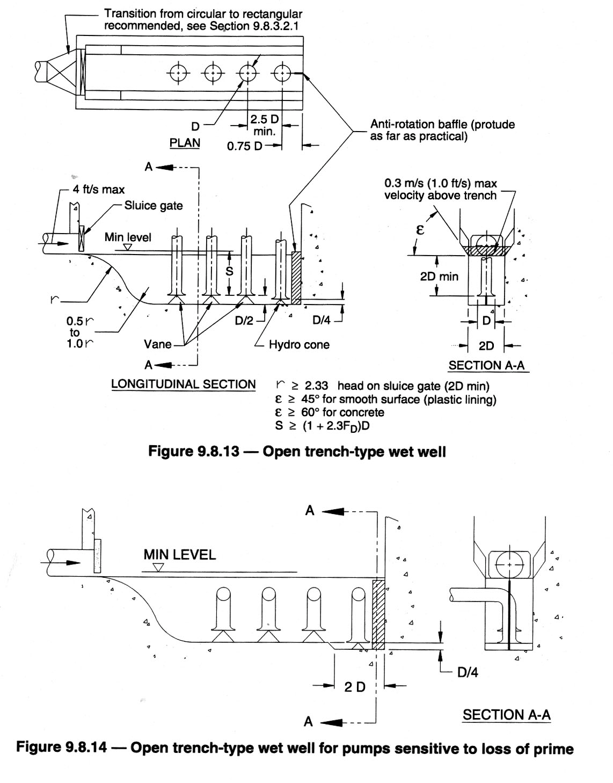
Self-Cleaning Trench-Type
Can be used for both variable speed and constant speed pumps

Slide 39
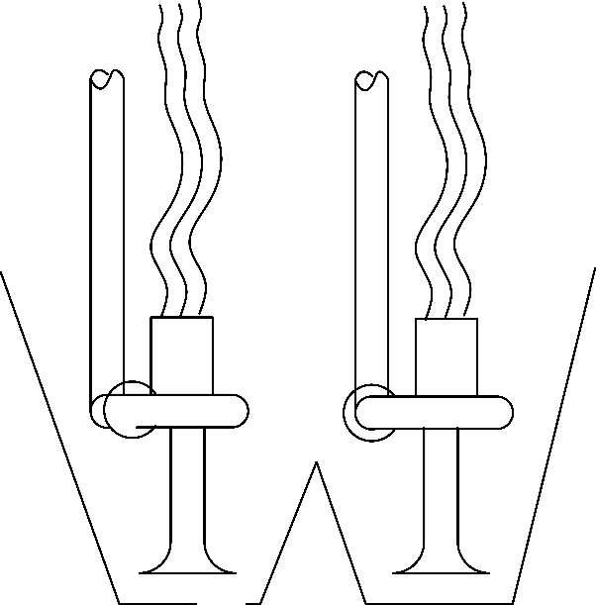
Small Self-Cleaning Wet Wells –
The Difference is in the Pump Intake
Flat Bottom; no nozzles
Shaped Bottom; nozzles

Slide 40
Pump
Foundations

Slide 41
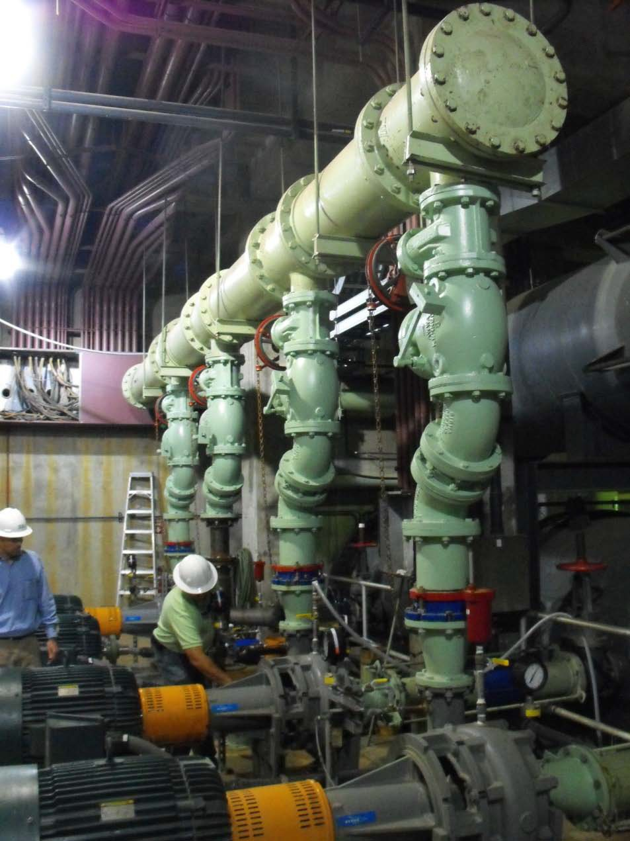

Slide 42
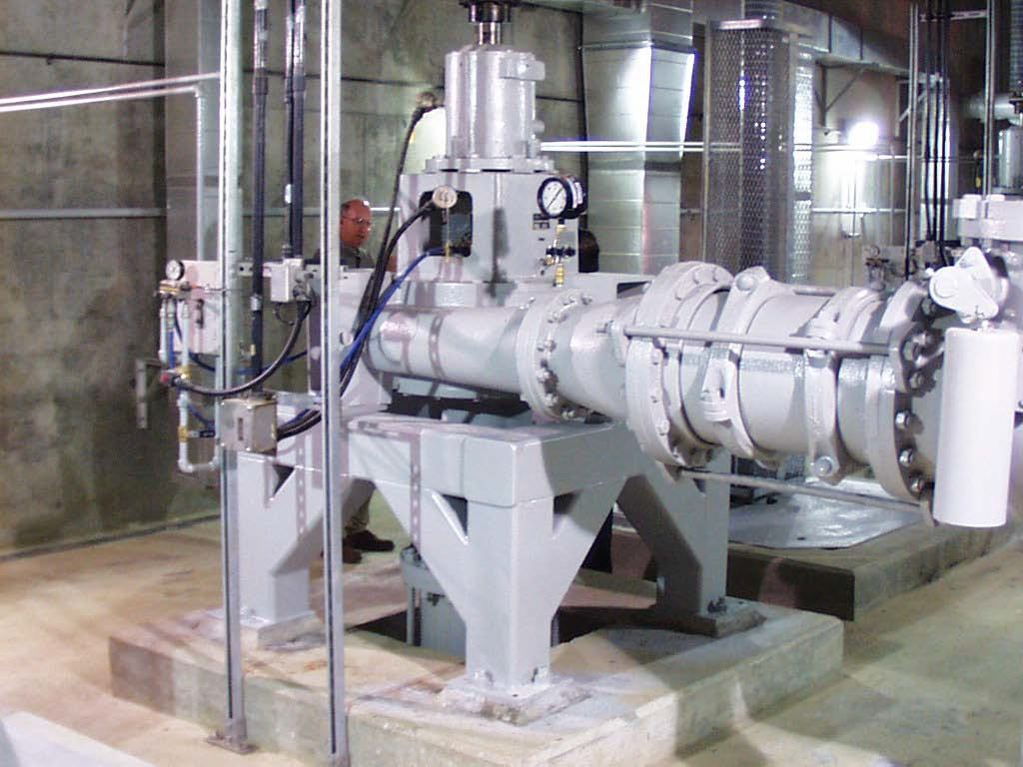
Foundations Are Important

Slide 43
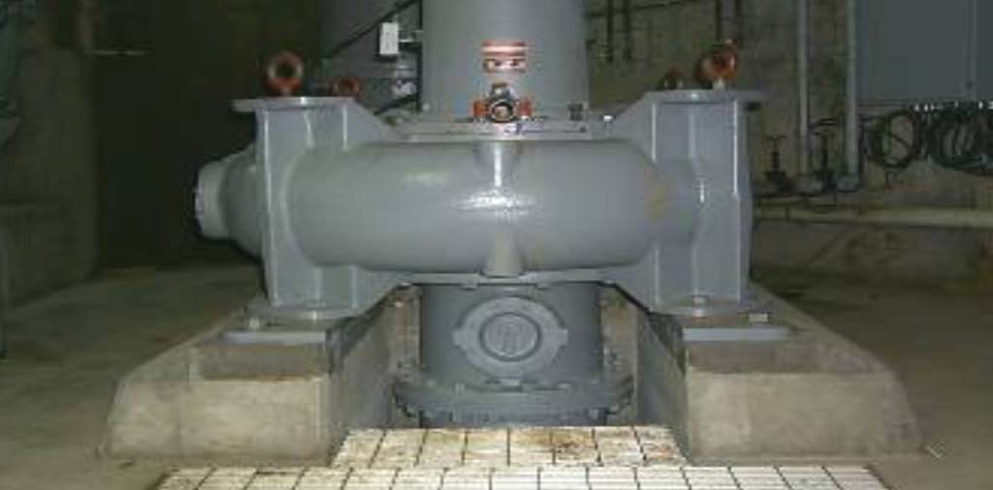
The Result

Slide 44
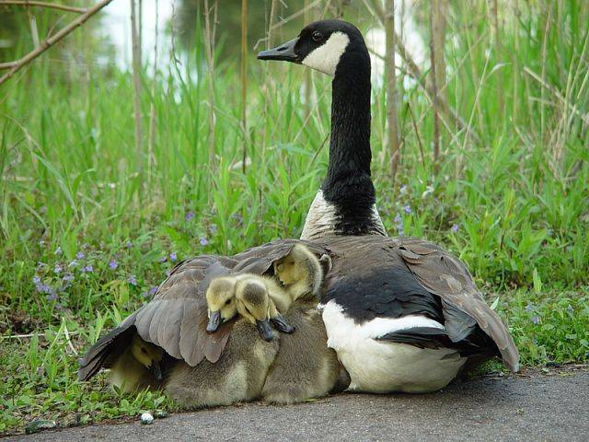
Questions?

